Slide 1
9.2_Transistors
PDS
SDN
NFV
Computer Vision
https://github.com/siagianp
https://www.youtube.com/@AmelOline/videos
https://github.com/amelcharolinesgn2/IoT_simulator-mqtt-NodeRed
https://github.com/amelcharolinesgn2/Cloud-Infrastructures
https://github.com/amelcharolinesgn2/ClouD-Infrastructure-SISKA-2025

Slide 2
What is a transistor?

Slide 3
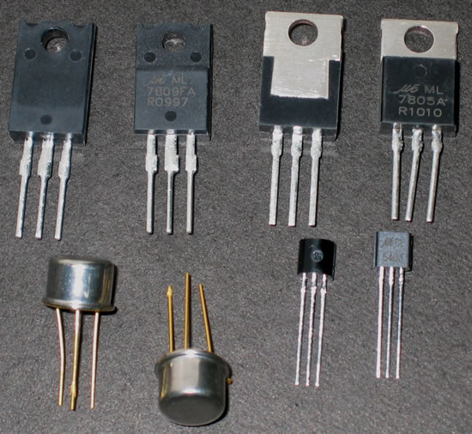
What is a transistor?
A transistor is a 3 terminal electronic device made of semiconductor material.
Transistors have many uses, including amplification, switching, voltage regulation, and the modulation of signals

Slide 4
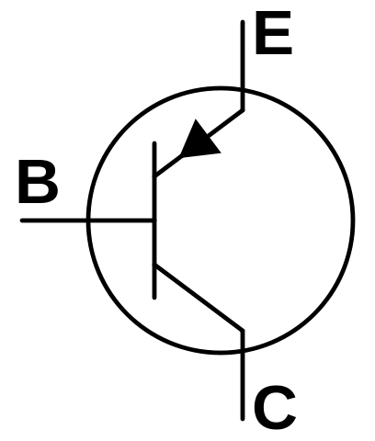
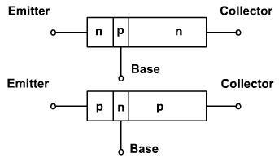
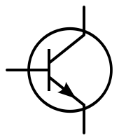
Bipolar Transistor
A transistor is basically a Si or Ge crystal containing three separate regions.

Slide 5
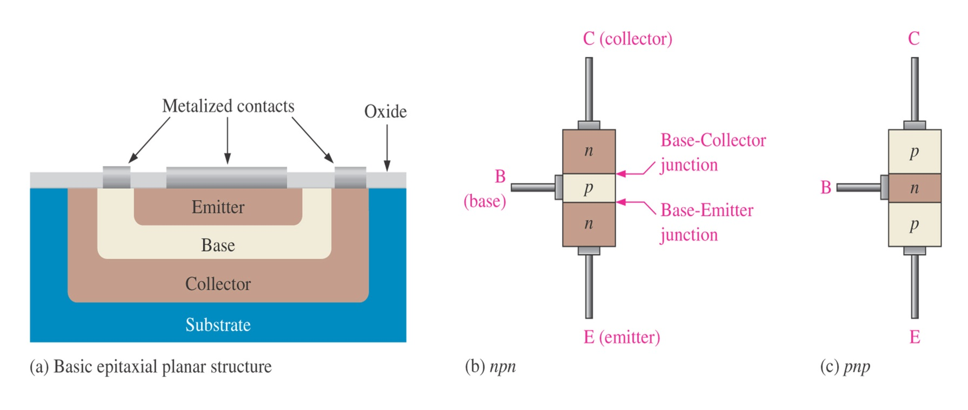
Architecture of BJTs
The bipolar junction transistor (BJT) is constructed with three doped semiconductor regions separated by two pn junctions
Regions are called emitter, base and collector

Slide 6
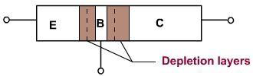
Bipolar Transistor
The depletion layers do not have the same width, because different regions have different doping levels.

Slide 7
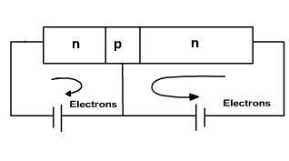
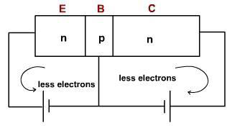
Biasing
If both the junctions are forward biased free electrons enter the emitter and collector of the transistor, joins at the base and come out of the base.
If both the junction are reverse biased then small currents flows through both junctions only due to thermally produced minority carriers and surface leakage.

Slide 8
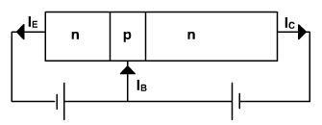
Biasing
When the emitter junction is forward biased and collector junction is reverse biased then one expect large emitter current and small collector current but collector current is almost as large as emitter current.

Slide 9
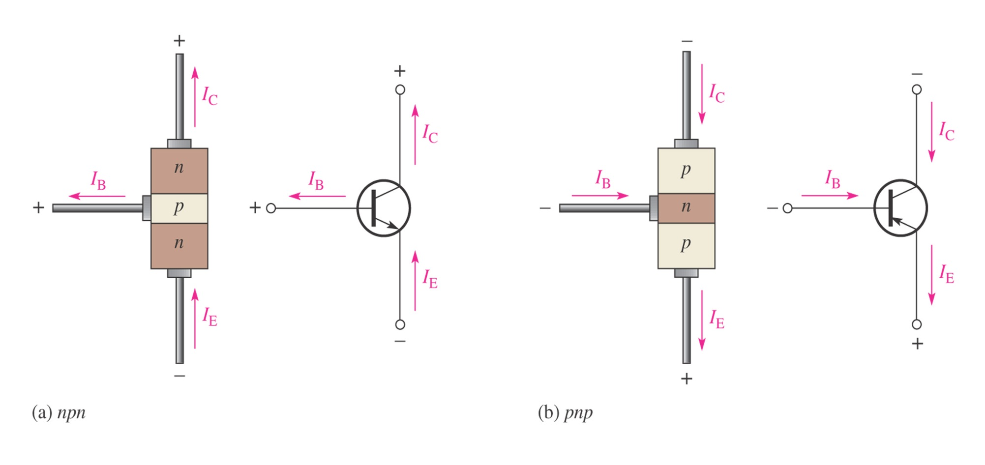
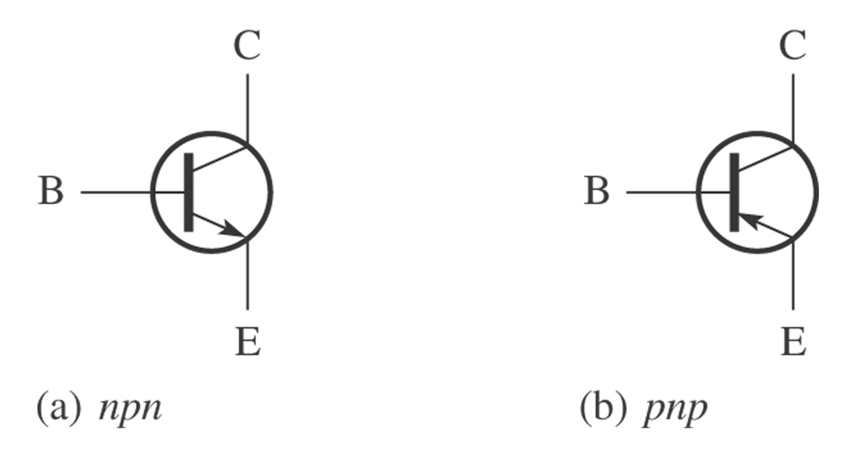

Transistor Current
The total current flowing into the transistor must be equal to the total current flowing out of it.
$$I_{E}=I_{C}+I_{B}$$

Slide 10
Transistor Applications
Switching
Amplification
Variable Resistor
Impedance Matching
Voltage Regulation

Slide 11
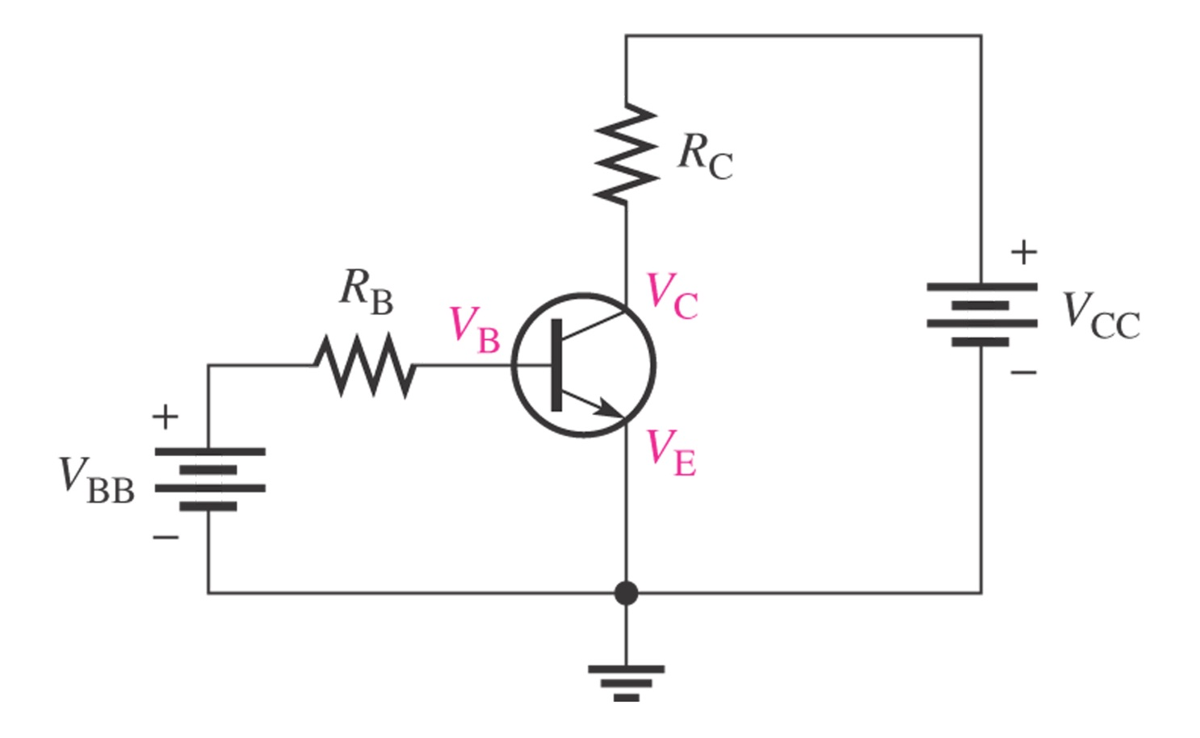
Basic circuits of BJT

Slide 12
Operation of BJTs
BJT will operates in one of following four region
Cutoff region (for digital circuit)
Saturation region (for digital circuit)
Linear (active) region (to be an amplifier)
Breakdown region (always be a disaster)

Slide 13
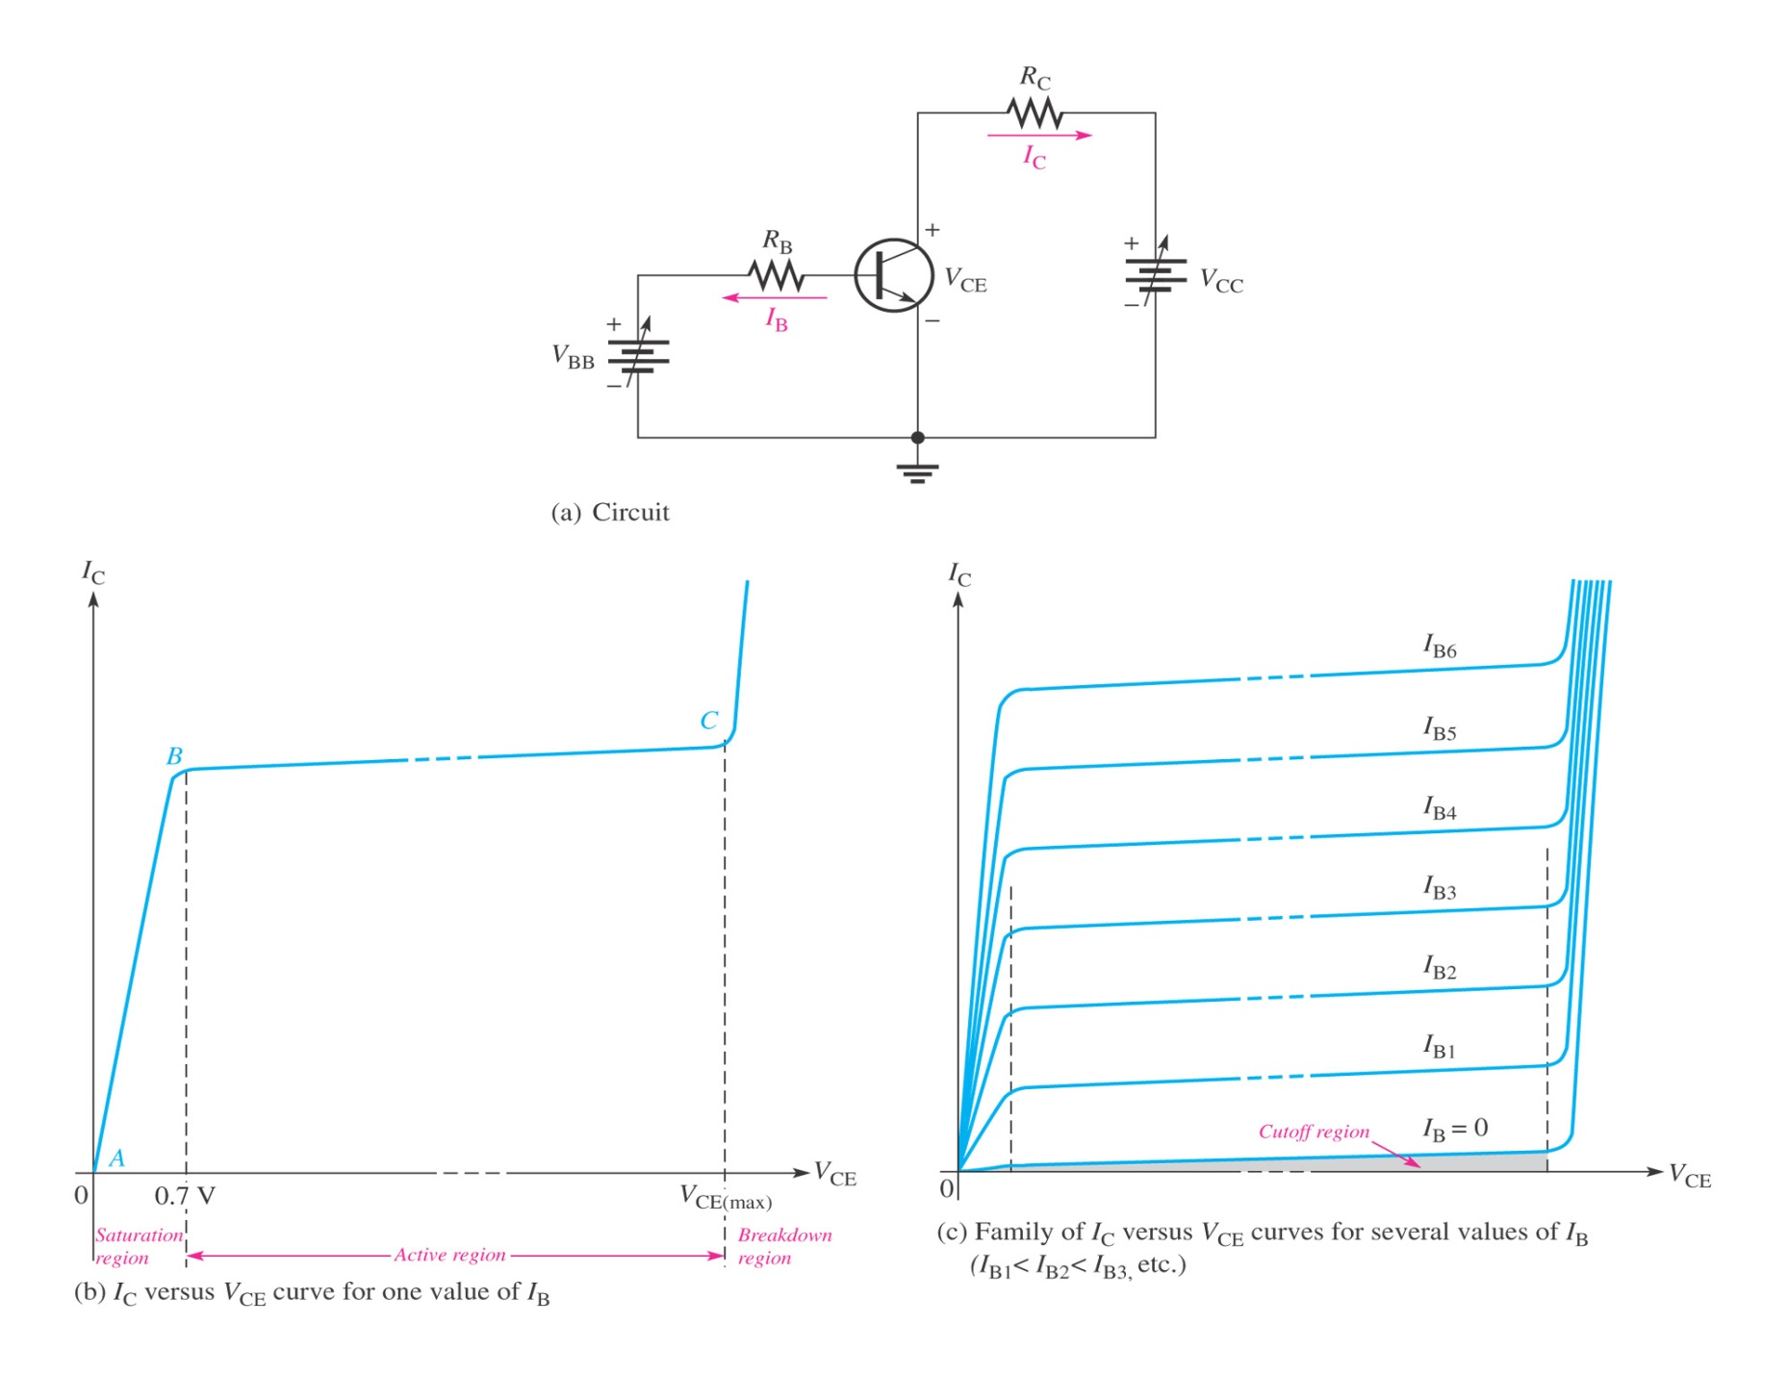
Operation of BJTs

Slide 14
DC Analysis of BJTs
Transistor Currents:
I_{E} = I_{C} + I_{B}
alpha (α_{DC})
I_{C} = α_{DC}I_{E}
beta (β_{DC})
I_{C} = β_{DC}I_{B}
β_{DC} typically has a value between 20 and 200

Slide 15
DC Analysis of BJTs
DC voltages for the biased transistor:
Collector voltage
V_{C} = V_{CC} - I_{C}R_{C}
Base voltage
V_{B} = V_{E} + V_{BE}
for silicon transistors, V_{BE} = 0.7 V
for germanium transistors, V_{BE} = 0.3 V

Slide 16
Q-point
The base current, I_{B}, is established by the base bias
The point at which the base current curve intersects the dc load line is the quiescent or Q-point for the circuit

Slide 17
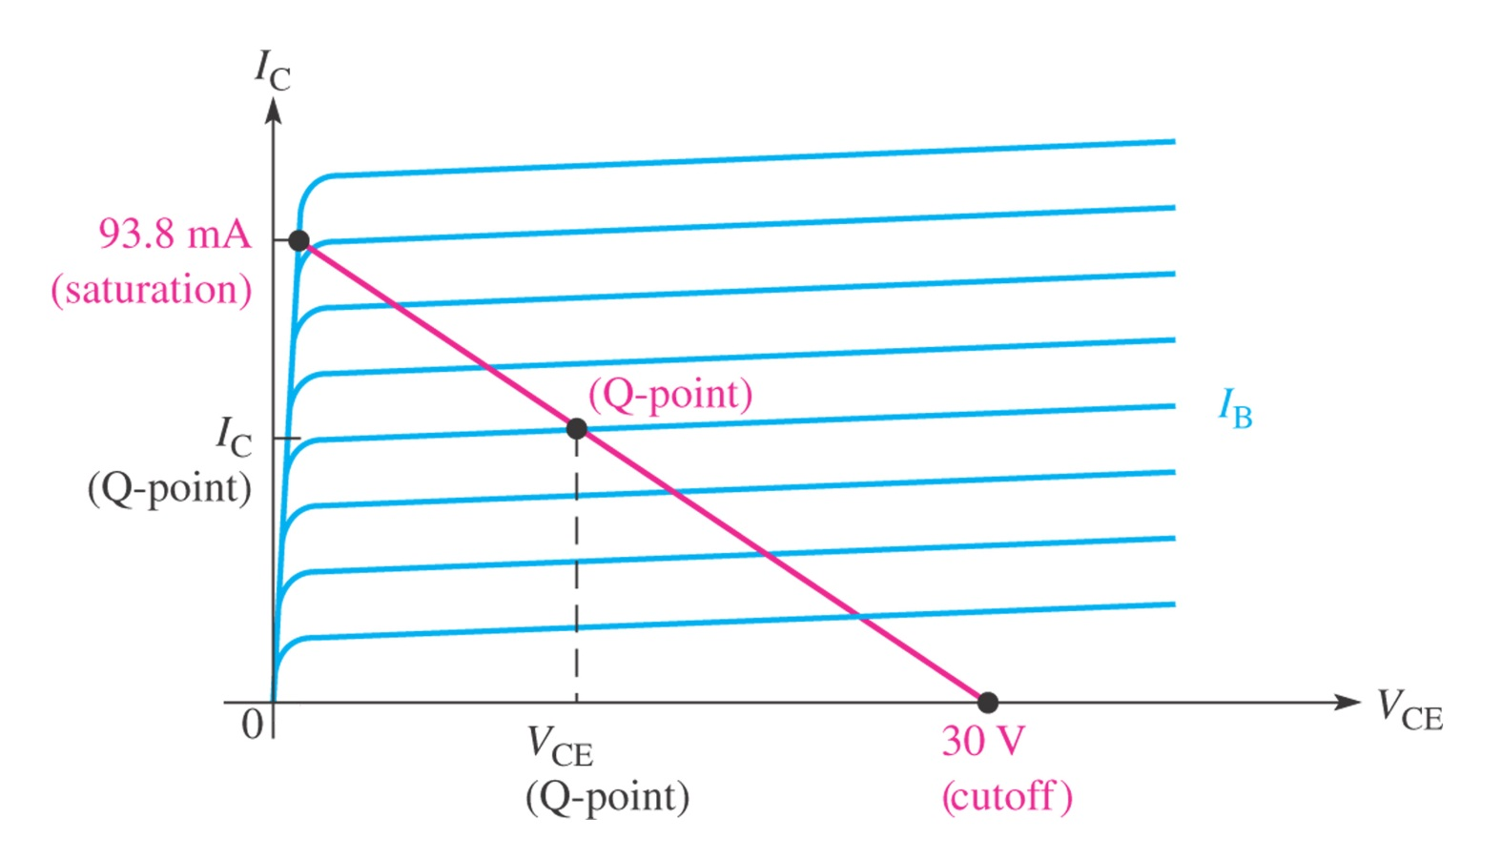
Q-point

Slide 18
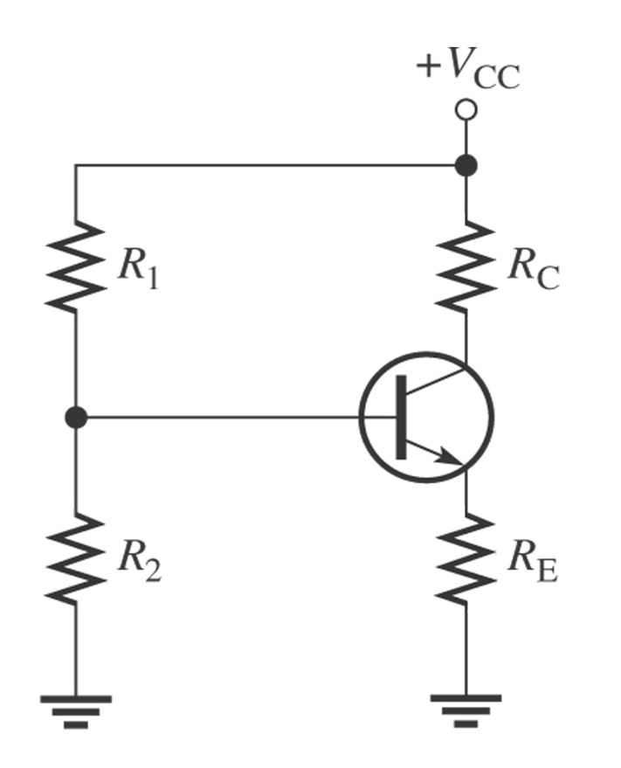
DC Analysis of BJTs
The voltage divider biasing is widely used
Input resistance is:
R_{IN} ≅ β_{DC}R_{E}
The base voltage is approximately:
V_{B} ≅ V_{CC}R₂/(R₁+R₂)

Slide 19
PDS
SDN
NFV
Computer Vision
Thank You !!
https://github.com/siagianp
https://www.youtube.com/@AmelOline/videos
https://github.com/amelcharolinesgn2/IoT_simulator-mqtt-NodeRed
https://github.com/amelcharolinesgn2/Cloud-Infrastructures
https://github.com/amelcharolinesgn2/ClouD-Infrastructure-SISKA-2025

